Slide 1
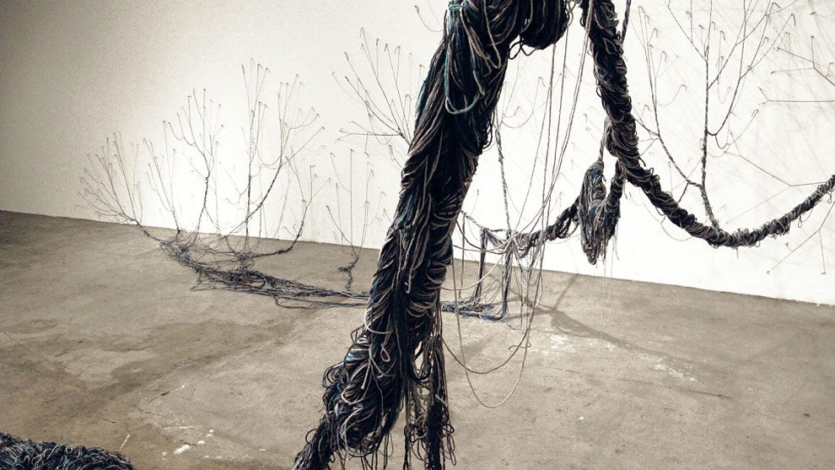
Intersectionality:
An analytical sensibility

Slide 2
today….
Mutual constitution of race and gender
Conceptualising intersectionality
Case study

Slide 3
What is intersectionality?
‘Intersectionality is an analytic sensibility, a way of thinking about identity and its relationship to power’ (Crenshaw 2015).
A theoretical and political concept
A tool for examining how forms of oppression ‘interlock’, overlap and compound each other; to make visible the experiences of those multiply marginalized
A tool for understanding the fundamental interdependence of processes and discourses of power
A starting point…

Slide 4
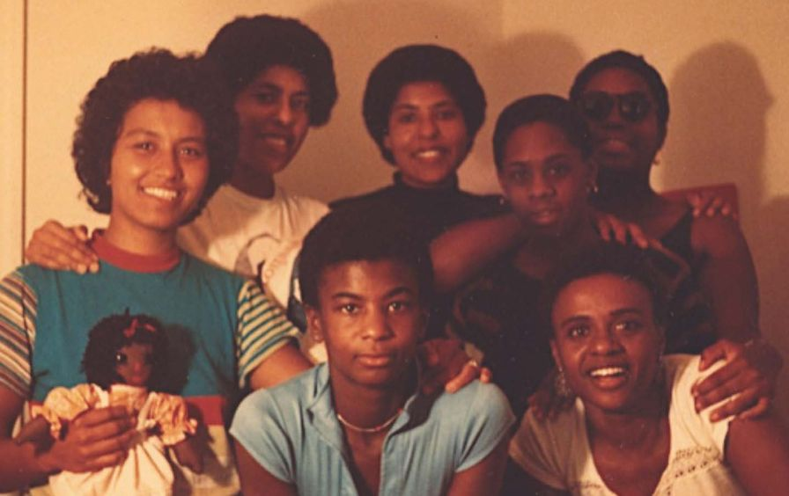
Combahee River
Collective
‘[We] see our particular task the development of integrated analysis and practice based upon the fact that the major systems of oppression are interlocking. The synthesis of these oppressions creates the conditions of our lives’ (210).
If Black women were free, it would mean that everyone else would have to be free since our freedom would necessitate the destruction of all the systems of oppression.
The Combahee River Collective in 1974. Left to right bottom: Demita Frazier and Helen Stewart. Left to right top: Margo Okazawa-Rey, Barbara Smith, Beverly Smith, Chirlane McCray, and Mercedes Tompkins. Photo: Margo Okazawa-Rey, Source: The Nation

Slide 5
What is intersectionality? Part 2.
Intersectionality is an analytical tool that ‘gives people better access to the complexity of the world and of themselves’ (Collins and Bilge 2016, 2)
Collins and Bilge discuss three case studies: the World Cup; Global social inequality; Black women’s movement in Brazil
Cores ideas of an intersectional framework: Social inequality; power; relationality; social context; complexity; social justice
Intersectionality describes the ‘complex, irreducible varied and variable effects which ensue when multiple axis of differentiation – economic, political, cultural, psychic, subjective and experiential- intersect in historically specific contexts. (Brah and Phoenix 2004, 76)

Slide 6
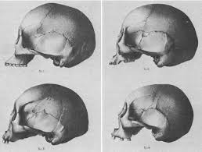
Categories as mutually constructed: gender and race
In late 19th century after extensive discourse on race had been elaborated, attention was turned to gender, and it was believed that scientists ‘could use racial difference to explain gender difference and vice versa’ (Leys Stepan 1986, 263)
In scientific discourse, “lower races represented the ‘female’ types of the human species and females the ‘lower race’ of gender” (264)

Slide 7
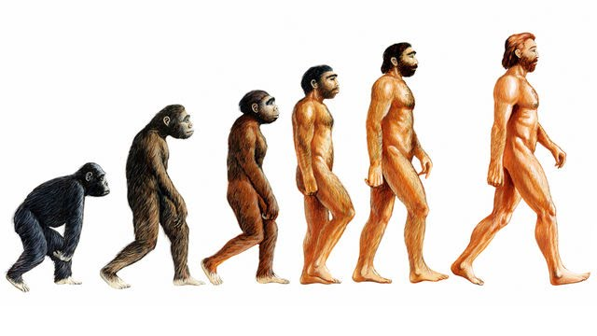
George Romanes in 1887: ‘We may predict with confidence that, even under the most favourable conditions as to culture, and even supposing the mind of man to remain stationary…it must take many centuries for heredity to produce the missing five ounces of the female brain’ (cited in New Scientist, 7 December, 1978).

Slide 8
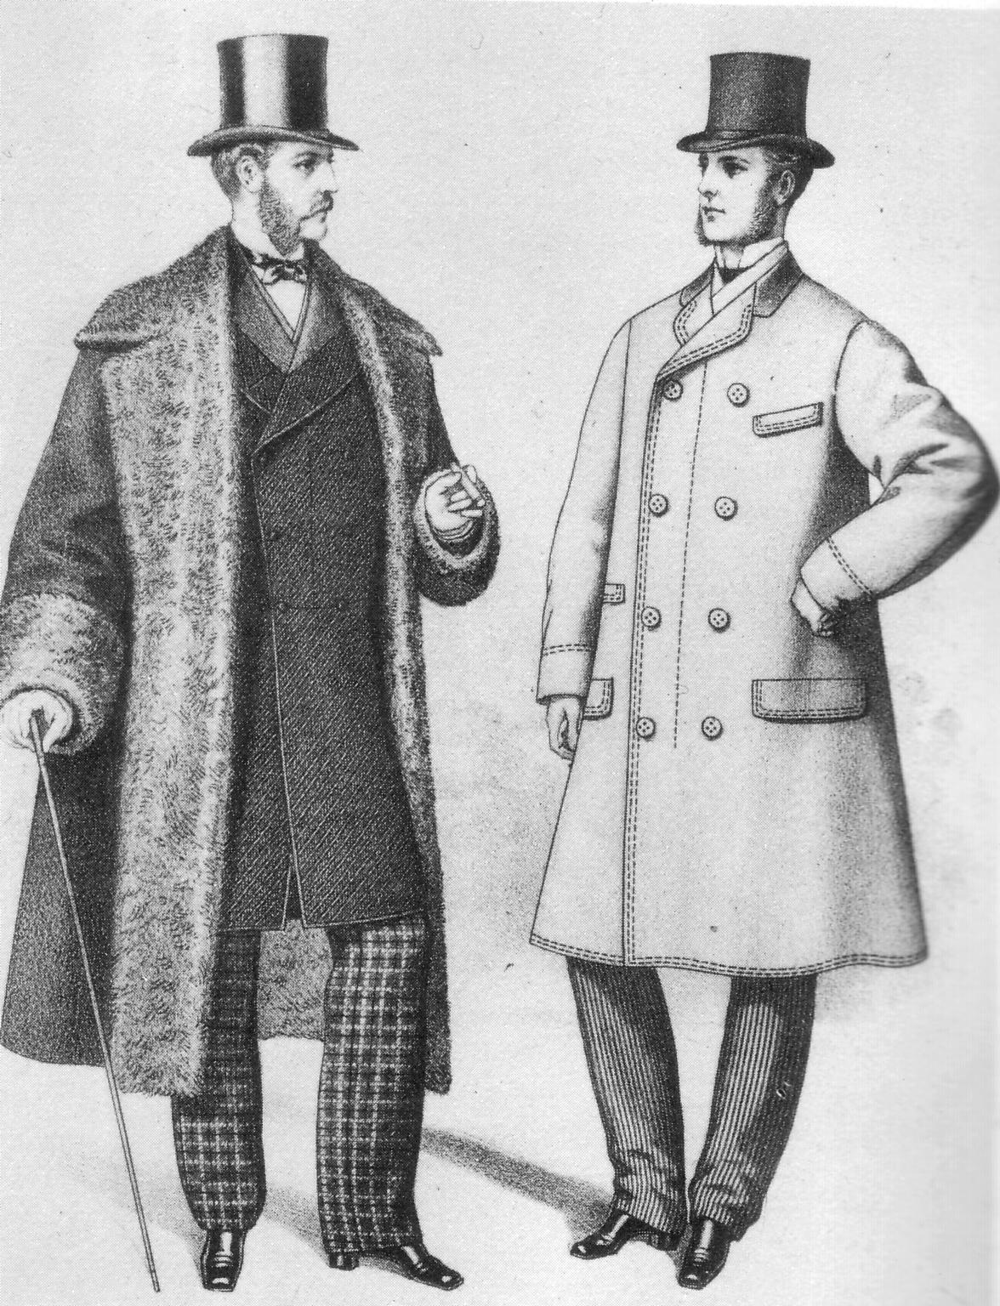
Manliness and ‘Civilization’
Advancement of civilization seen as a ‘perfected racial evolution and gender specialization’ (26)
Manhood- a process which creates ‘men’ by linking male genital anatomy to a male identity and both anatomy and identity to authority and power (Bederman 1995, 7-8).
Ideologies of manliness were thus similar to- and frequently linked with- ideologies of civilization. Just as manliness was the highest form of being male, so civilization was the highest form of humanity. Manliness was the achievement of a perfect man, just as civilization was the achievement of a perfect race (27).

Slide 9
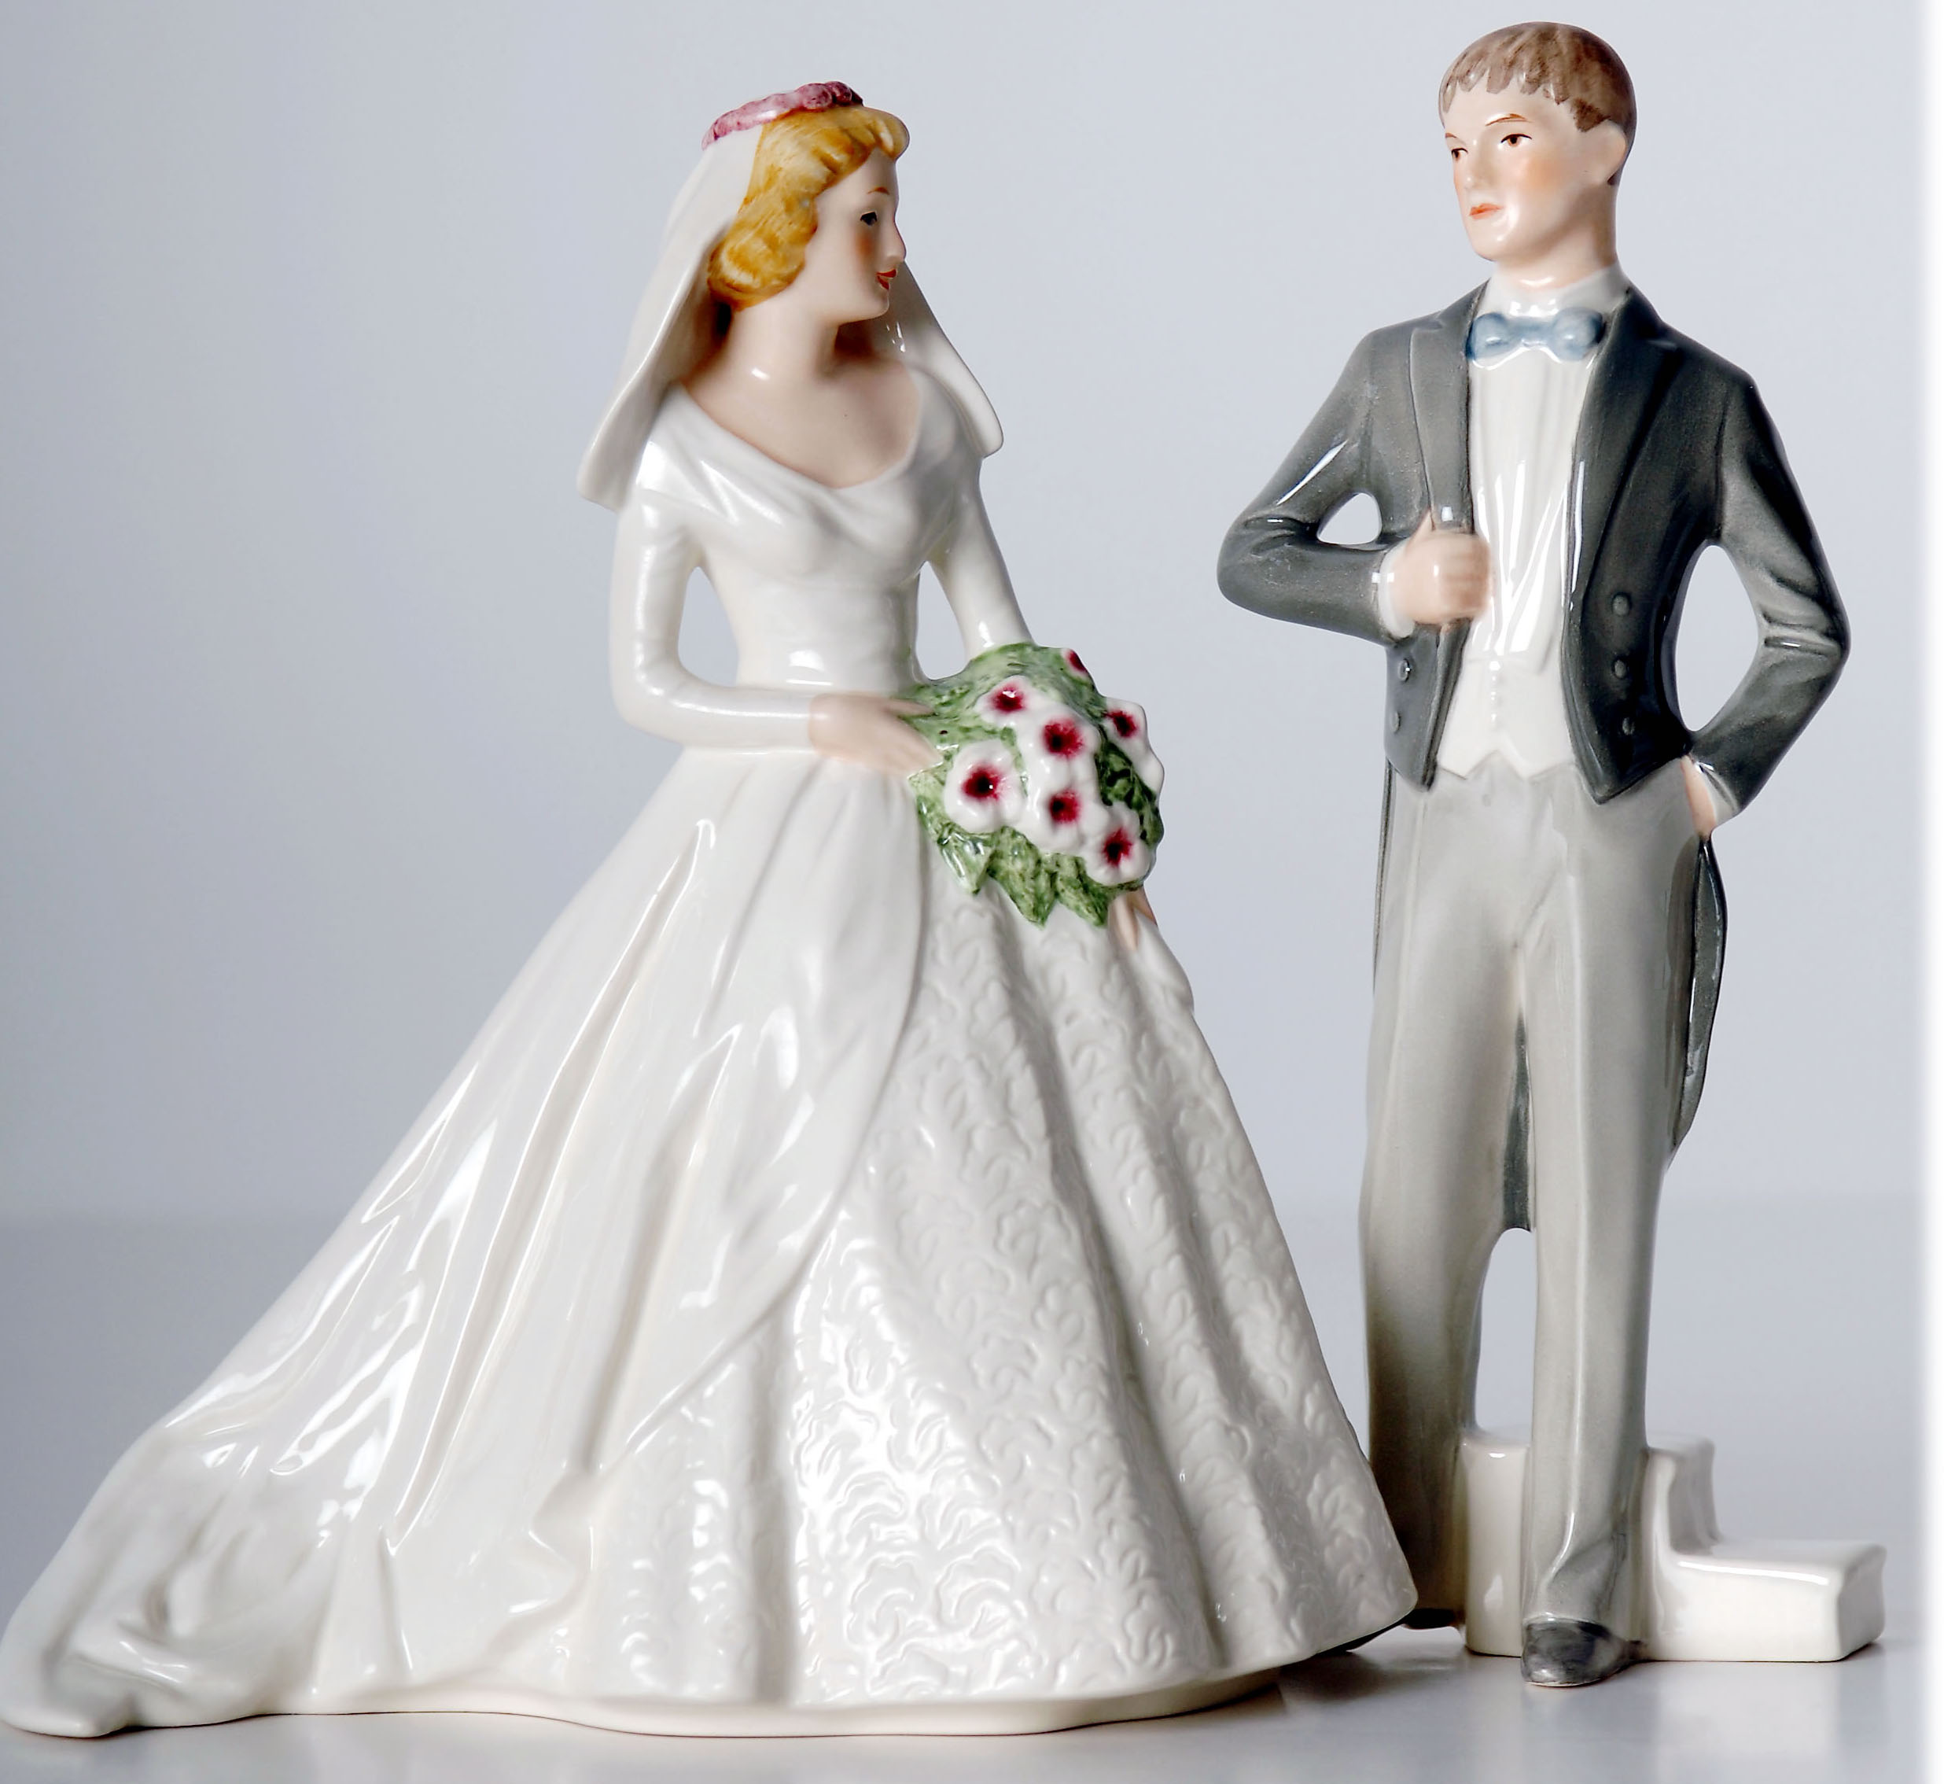
An ‘ungendering’
‘[B]lack women were situated in opposition to the normative gender position, and produced outside of binary oppositional categories as something else altogether; that ‘else’ was contradictory and ambiguous but in black women’s lives it fundamentally meant exposure to violence.’ (Haley 2016: 88)
Notes:
‘Black people experience a highly visible sexualized racism, one where the visibility of Black bodies themselves reinscribes the hypervisibility of Black men and women’s alleged sexual deviancy’ (Hill Collins 130).

Slide 10
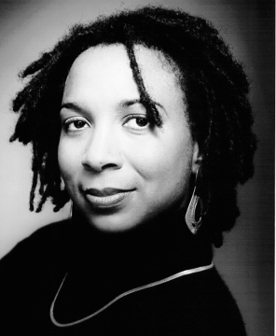
Mapping the Margins
Identity politics problematic because it ignores intragroup difference
Racism and sexism treated as ‘mutually exclusive terrains’ – including by feminist and anti-racist activists
‘Although racism and sexism readily intersect in the lives of real people, they seldom do in feminist and antiracist practices. And so, when the practices expound identity as woman or person of color as an either/or proposition, they relegate the identity of women of color to a location that resists telling’ (1242).

Slide 11
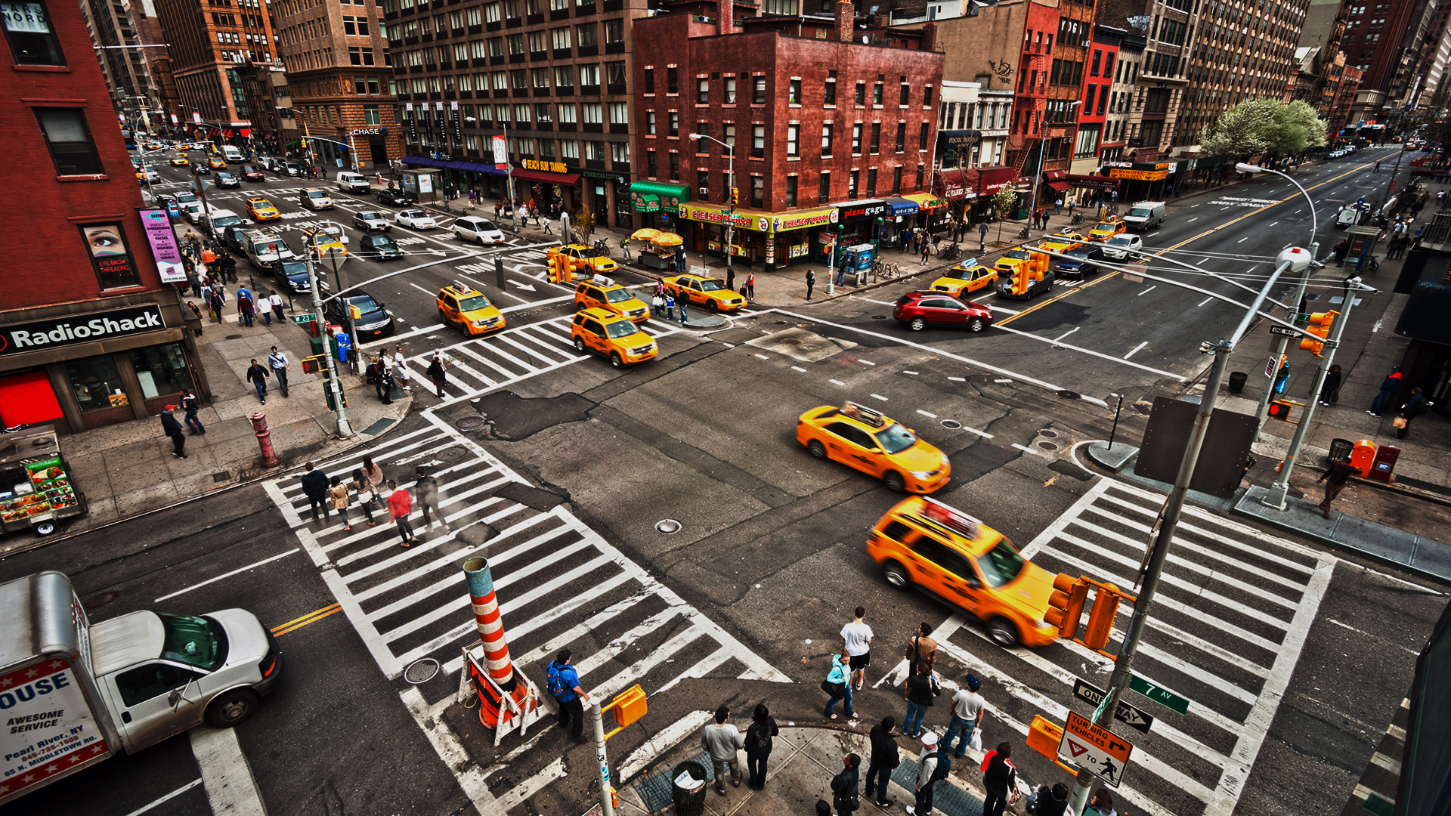
‘Intersectionality’ offers ‘a gridlock model that fails to account for the mutual constitution and indeterminacy of embodied configurations of gender, sexuality, race, class, and nation’ (Grosz cited in Puar).
‘[I]n mapping the intersections of race and gender, the concept does engage dominant assumptions that race and gender are essentially separate categories. By tracing the categories to their intersections, I hope to suggest a methodology that will ultimately disrupt the tendencies to see race and gender as exclusive or separable’ (1991, 1244 n. 9).

Slide 12
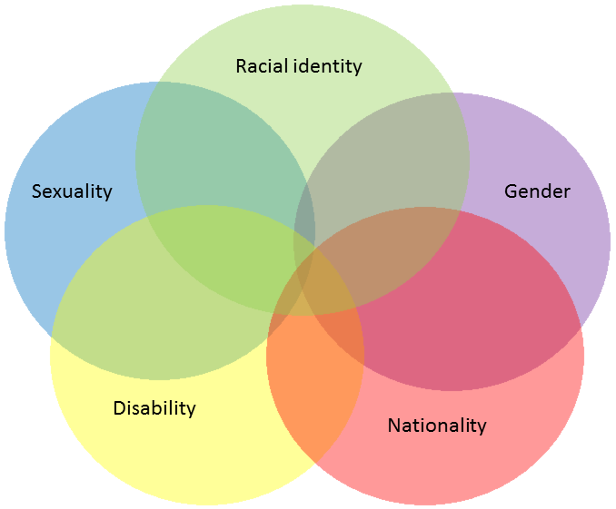
Contradictory locations
Forms of social distinction and inequality are produced in complex combinatories of social location…forged through multiple sites. (Gibson 2013)
social categorisations are not equally positioned or salient at all times; they change over time and in different contexts; complex new constellations of disadvantage emerge across time and space
Rather than ‘as traits that individuals “have”’, what if 'we look at how difference is defined and determined relationally, such that it appears between and across, rather than within, people’? (Gibson 2013)
The ‘venn diagram’ view of intersectionality that Gibson critiques

Slide 13
Contradictory Locations
We often find ourselves in ‘contradictory locations’ - subordinate in some times and places, and more dominant in others’ (Anthias 2012, 107)
One can belong, though in a number of different ways (stronger or weaker, affectual, legal, etc.).
At the same time as belonging in some ways, one can also not belong in other ways (e.g. one can belong as a member of the labour market and yet not belong as a citizen). In addition, for example, youngsters from migrant backgrounds can belong to two or more ‘nations’ or ‘ethnicities’….
At the same time they can be excluded from various aspects of these.

Slide 14
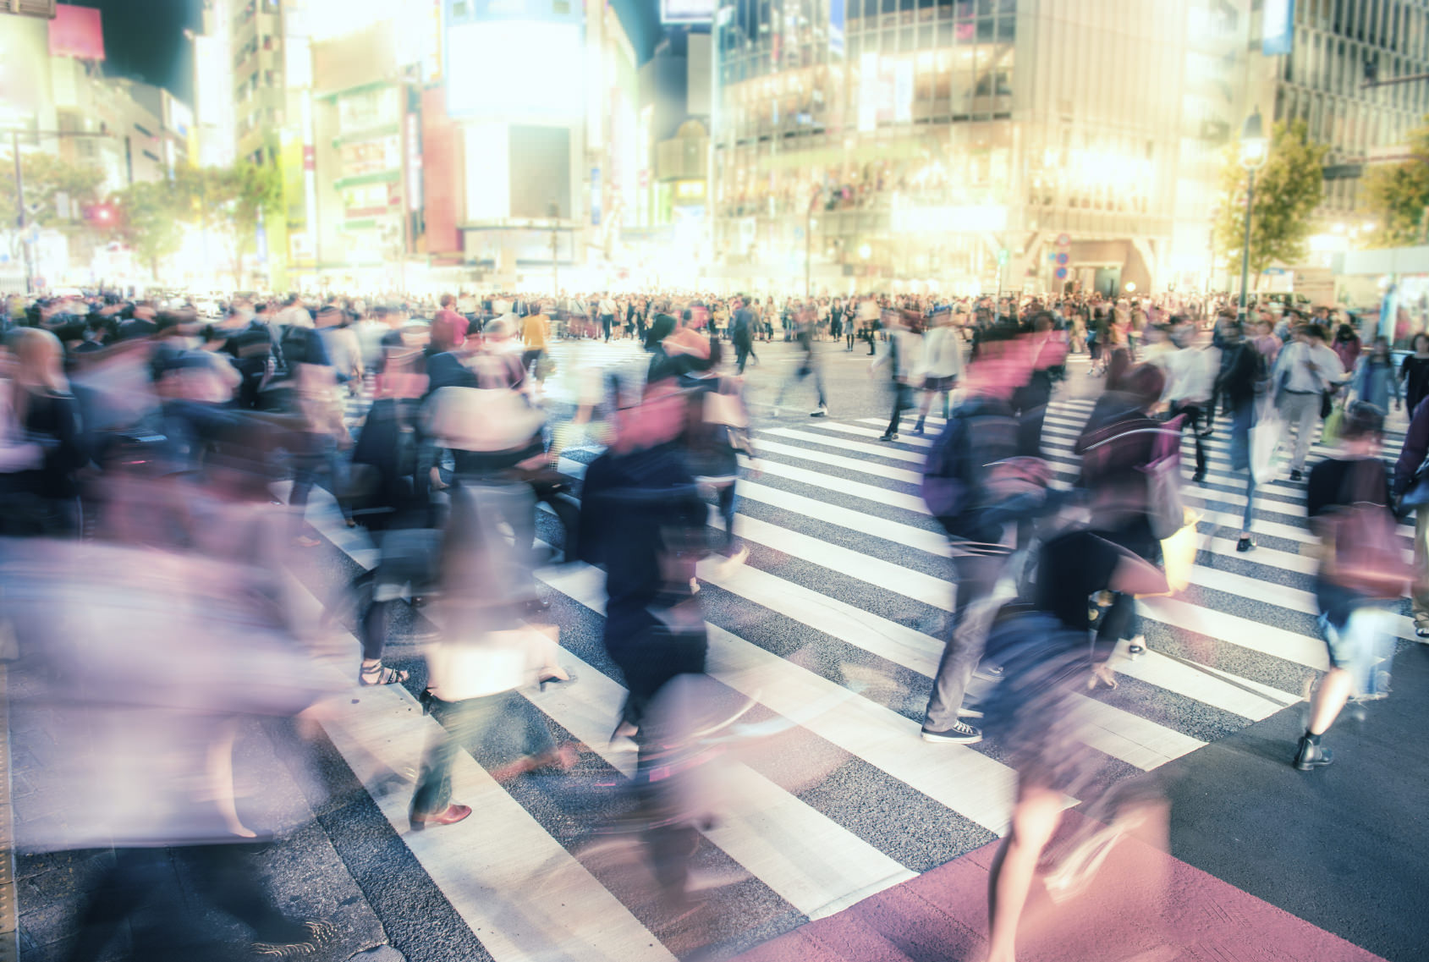
Social location‘is embedded in relations of hierarchy within a multiplicity of specific situational and temporal contexts, in which race gender nation have different meanings and effects.’ (Anthias 2014)
'Rather than a time-frozen picture where permanent categories are contained within individual bodies and identities, what would happen if we instead attended to intersectionality as produced through embodied, institutionally situated, relational narratives?’ (Gibson 2013)

Slide 15
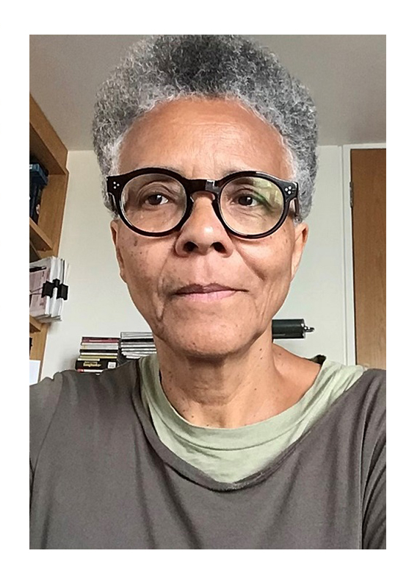
The capacity of theory from the margins
‘…black women and other women of color produce knowledge and that this knowledge can be applied to social and cultural research beyond the issues and processes deemed specific to women racialized as minority, that it can become part of a more generalizable theoretical, methodological, and conceptual tool kit.’
Gail Lewis, (2013)“Unsafe Travel: Experiencing Intersectionality and Feminist Displacements,” Signs: Journal of Women in Culture and Society
Gail Lewis

Slide 16
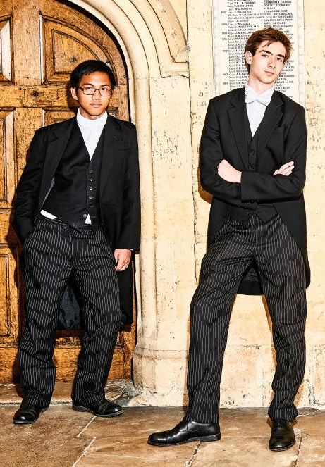
Theory of marginalized subjectivity or a generalized theory of identity?
Can it also be used to examine the ways in which ‘positions of dominance and subordination work in complex and intersecting ways to constitute subjects’ experiences of personhood’?
Should intersectionality scholarship ‘broaden its reach to theorize an array of subject experience(s). (Nash 2008:10)
Notes:
We need a ‘conceptualization of identity that captures the ways in which race, gender, sexuality, and class, among other categories, are produced through each other, securing both privilege and oppression simultaneously’.
White women and Kavanaugh

Slide 17
Intersectionality across borders?
Most applications of intersectionality focus on the global North- especially the US and the UK
Most focus on domestic dynamics rather than cross-border dynamics –which are integral to local processes; nationally bound rather than transnational
How do categories such as race and gender intersect across borders?
‘Patriarchies of colonial Europe were a racialized, gendered and transterritorial phenomenon…they affected so-called domestic gender relations on both sides of the colonial divide.’ (Patil 2013, 856)

Slide 18
Seeking asylum: Intersections of nationality, gender and sexuality
UKBA staff and judges often assume that a person can only be lesbian or gay if they have engaged consistently and exclusively in same-sex sexual activity.
The UKBA penalises gay people if they are not immediately open about their sexual orientation.
UKBA staff do not have access to information on the experiences of lesbians. Issues concerning forced marriage, honour killings and marital rape are not acknowledged to be relevant to lesbians
UKBA staff and judges often conclude that gay people can return to their home country and no longer be at risk if they are ‘discreet’ about their sexual activity or identity. (Stonewall 2010)
Notes:
Questions focus on sexual activity and asylum-seekers are expected to share explicit sexual experiences.
If a case reaches the appeal court
This approach has been condemned by the United Nations High Commissioner for Refugees (UNHCR)

Slide 19
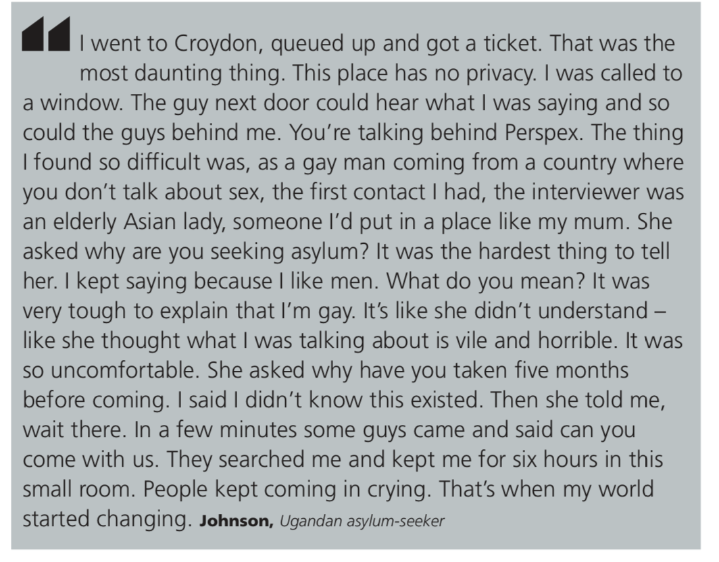

Slide 20
What questions can we ask through an intersectional lens?
historical and/or contemporary
local and/or transnational
quantitative and/or qualitative
about institutions; state power; culture; and/or the intimate, psychic and interpersonal

Slide 21
Practicing an intersectional lens
Read the short article.
Think across all the various dimensions that an intersectional lens might illuminate (historical, institutional, interpersonal, structural, experiential).
What research questions might you ask?
Notes:
https://www.hrw.org/report/2022/01/17/i-want-us-live-humans-again/families-temporary-accommodation-london-uk

